Slide 1
TWITTER LIVE FEED ANALYSYS AND STREAMING
FOR MOVIE AND COVID BASED TWEERS

Slide 2
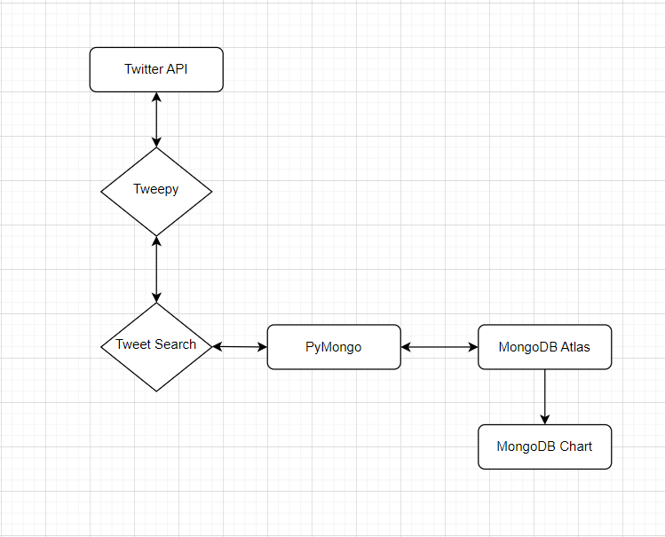

Slide 3
DATA - STREAMING AND CREATION

Slide 4
To Get a Twitter Api
Create a Twitter Developer Account
Get an elevated Access
Create An application under a project
Give access to the application
Get the authentication credentials

Slide 5
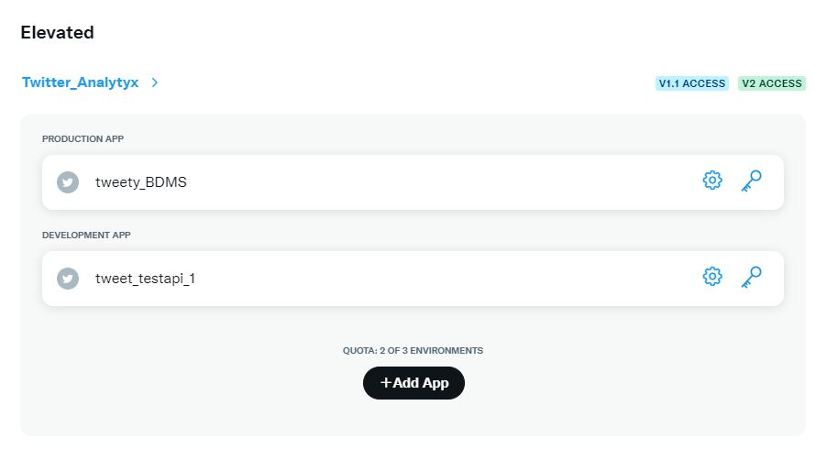
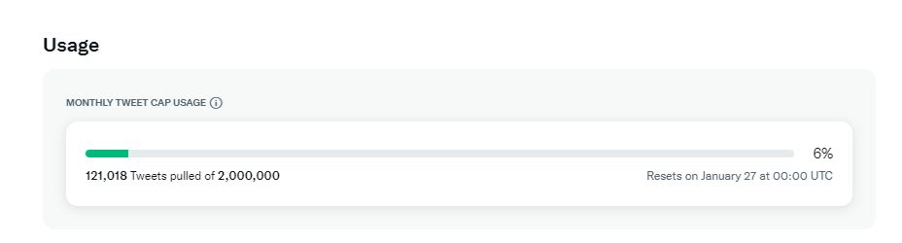
TWITTER API

Slide 6
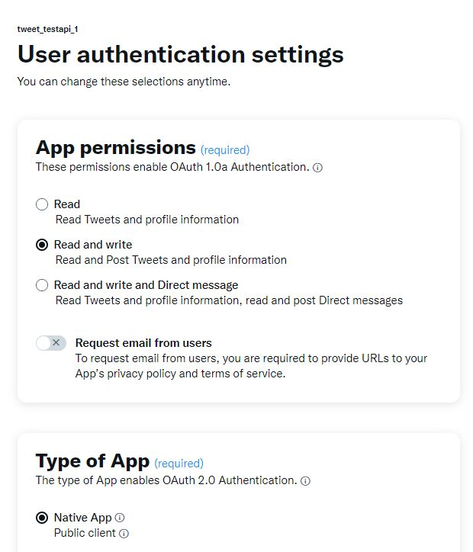
GIVING ACCESS FOR TWITTER API

Slide 7
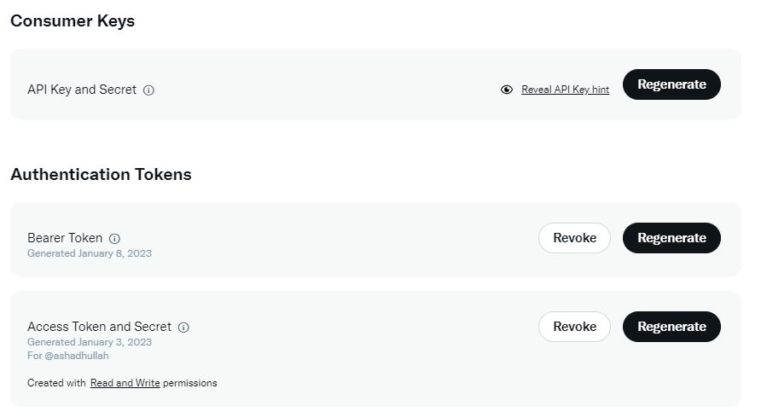
AUTHENTICATION KEYS

Slide 8
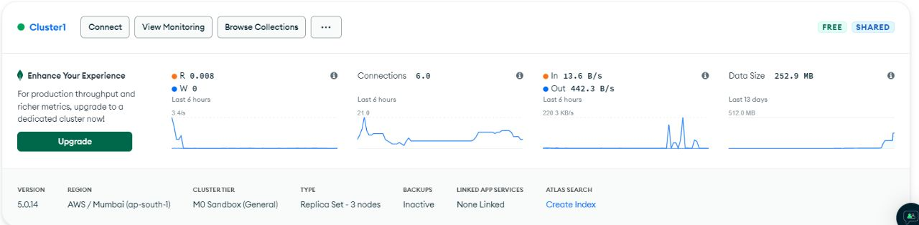
MONGODB CLUSTER

Slide 9
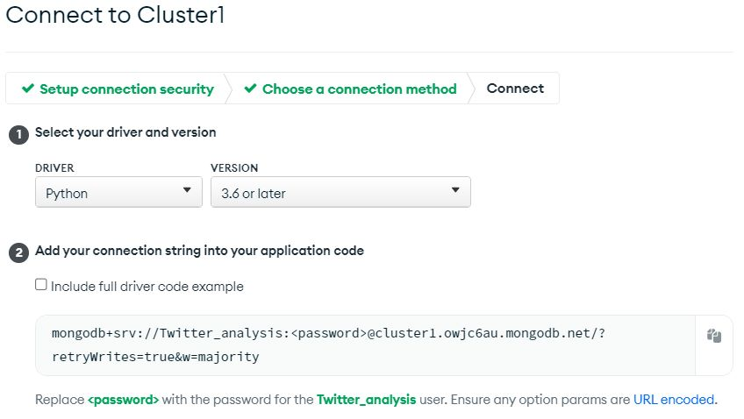
MONGODB URI CONNECTION STRING

Slide 10
We use tweepy module to access and stream the twitter data
We authenticate the api using the authentication credentials:
Consumer_key
consumer_secret
access_token
Access_secret

Slide 11
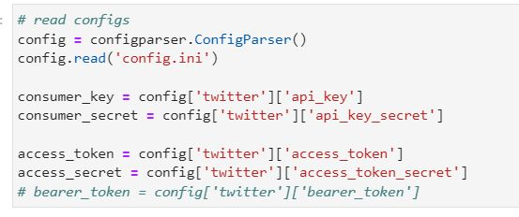
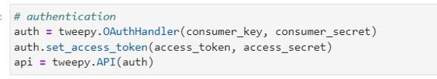
Authenticating API with keys

Slide 12
Connecting to DataBase:
Create an account in mongodb atlas
Create database in atlas
Giving the network accessibility in atlas
We can get the URI connection string and we can access and modify the data in mongodb database

Slide 13
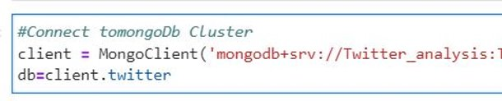
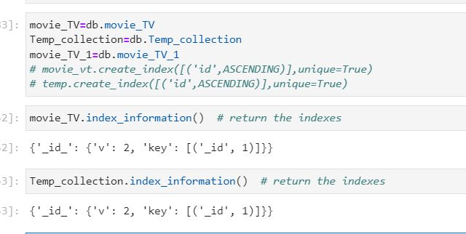
CONNECTING MONGODB AND CREATING COLLECTION

Slide 14
Streaming the twitter data:
search _Tweets function helps us to search and get the recent tweet with different parameters
API.search_tweets(q, *, geocode, lang, locale, result_type, count, until, since_id, max_id, include_entities)

Slide 15
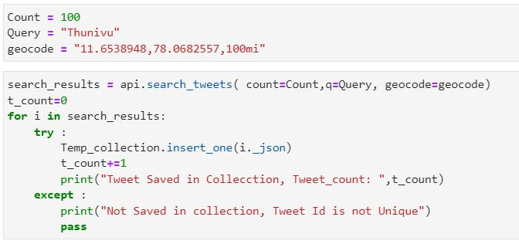
GETTING API FROM SEARCH_TWEETS FUNCTION

Slide 16
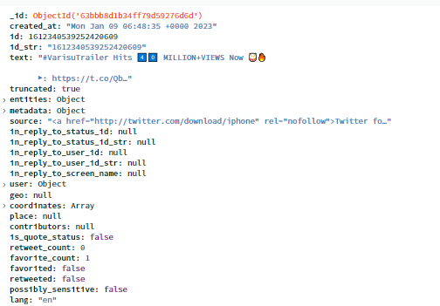
COMPLETE DATA OF SINGLE TWEET

Slide 17
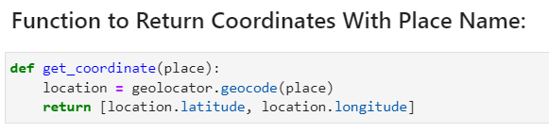
ANALYSING TWEET DATA AND UPDATING THE LOCATION COORDINATES ,MOVIE NAME AND TWEET TYPES

Slide 18
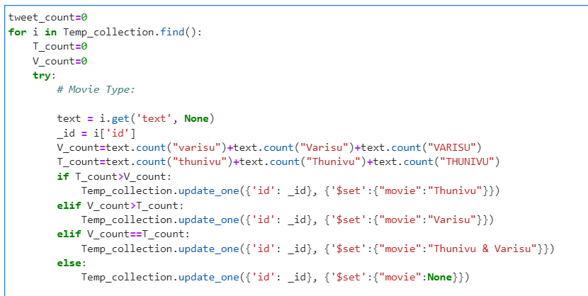

Slide 19
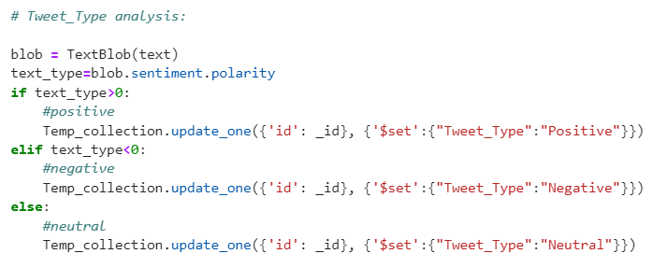

Slide 20
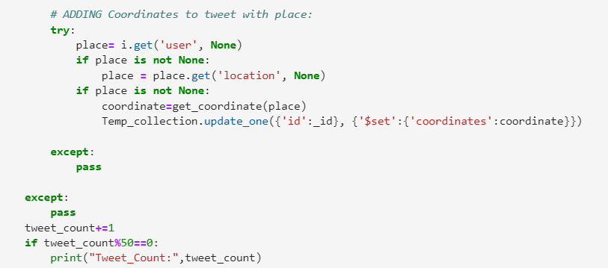

Slide 21
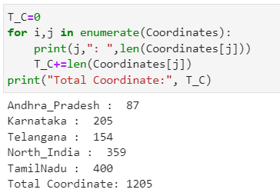
Coordinates list of various place:

Slide 22
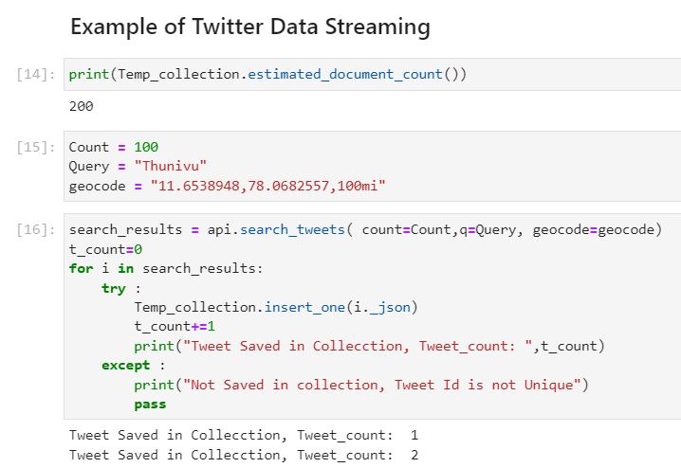

Slide 23
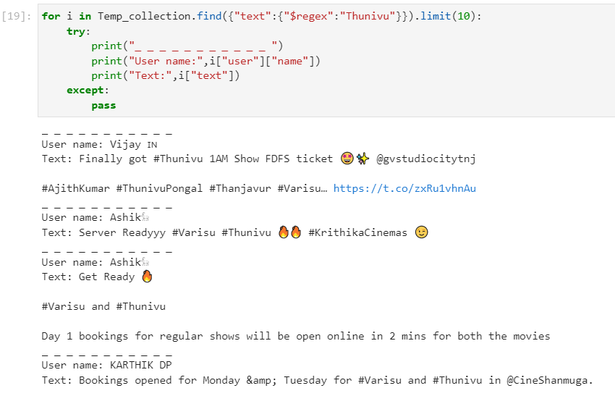

Slide 24

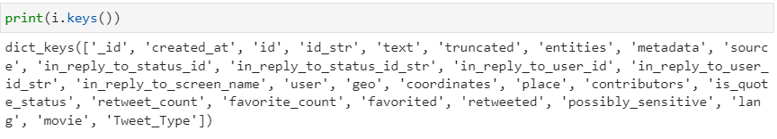
Main Fields in tweet data

Slide 25
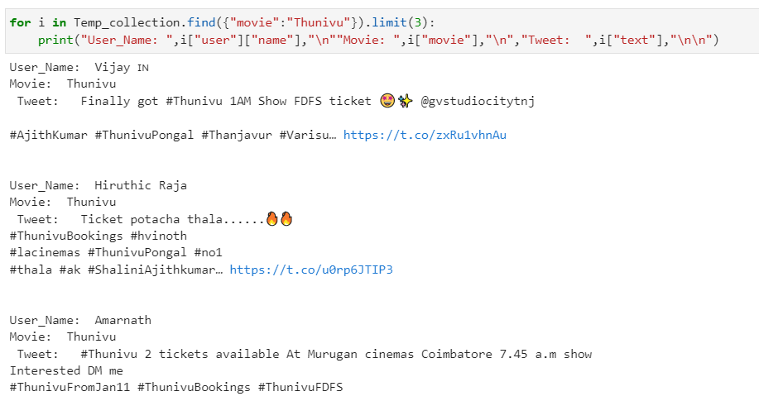
After Setting Coordinates, Movie Name And
Tweet_Type:

Slide 26
Tweet Data Analysis

Slide 27
MongoDb Chart Analysis

Slide 28
Link For Analysis Chart
Movie Analysis Chart

Slide 29
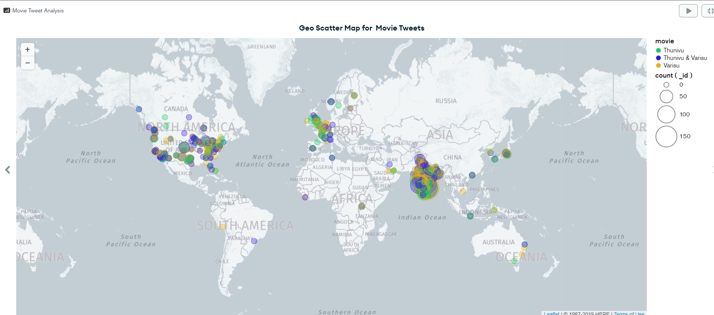
GEO SCATTER MAP FOR MOVIE TWEETS

Slide 30
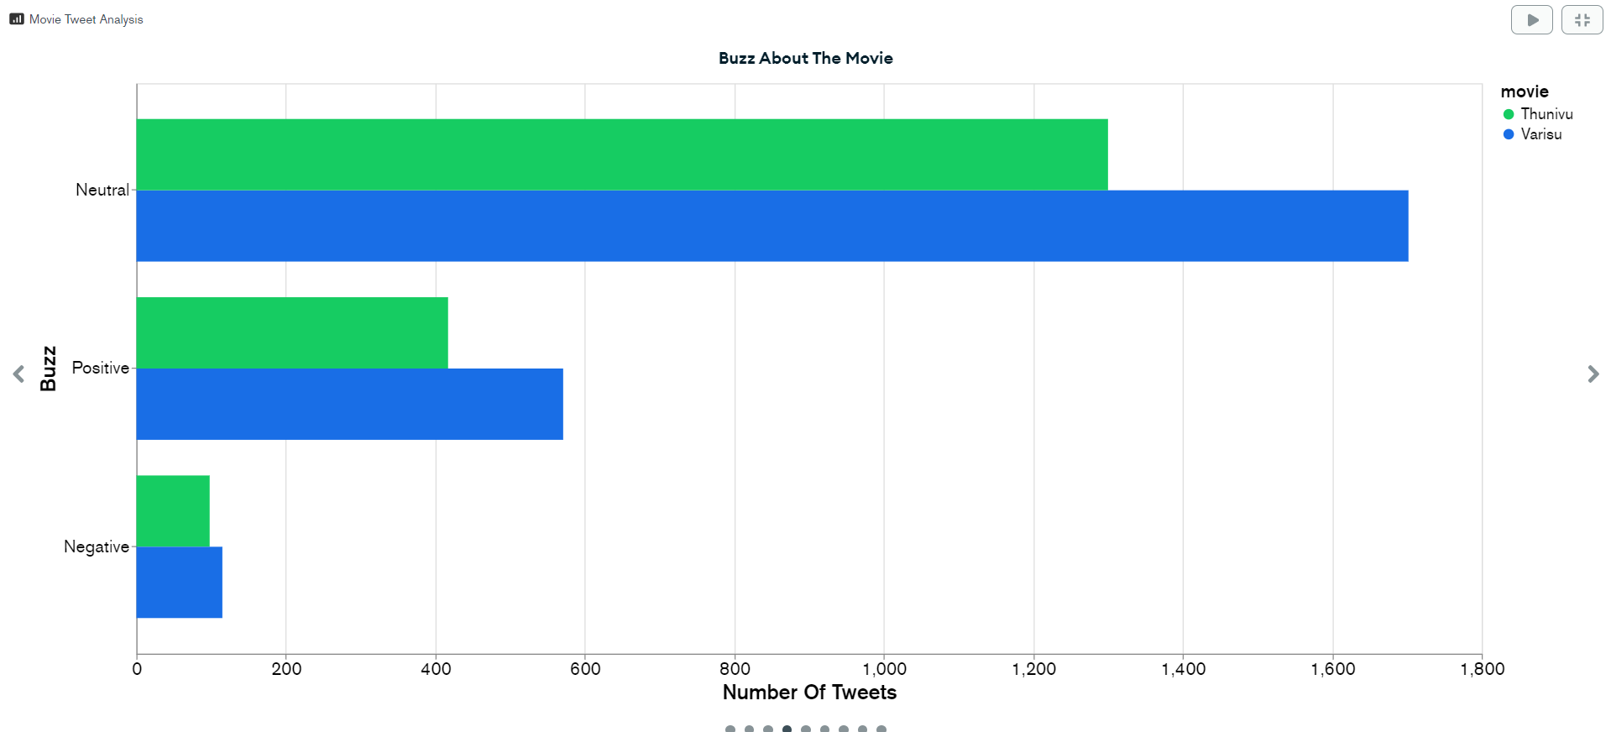
BUZZ ABOUT THE MOVIE

Slide 31
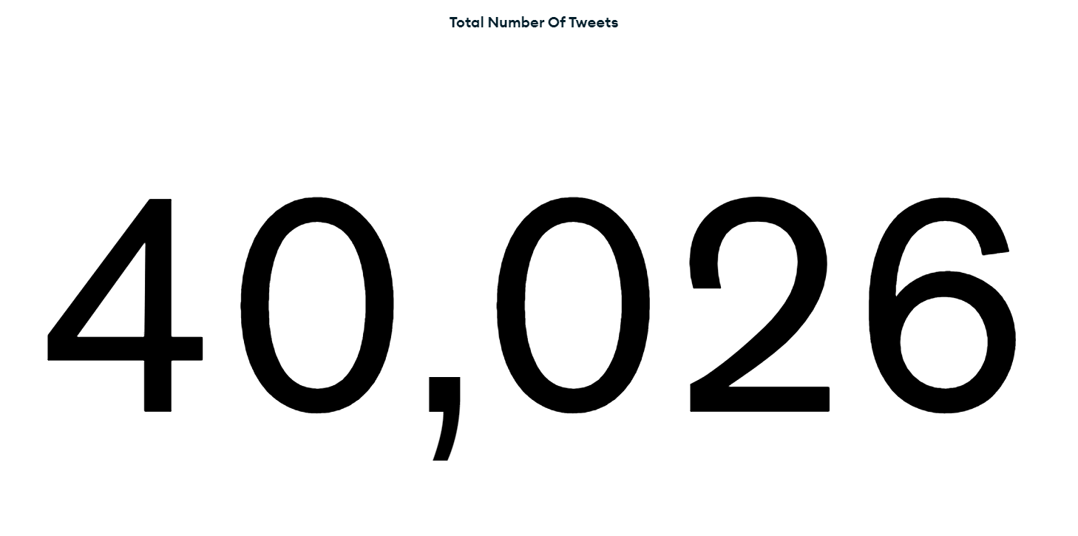
TOTAL NO OF TWEETS

Slide 32
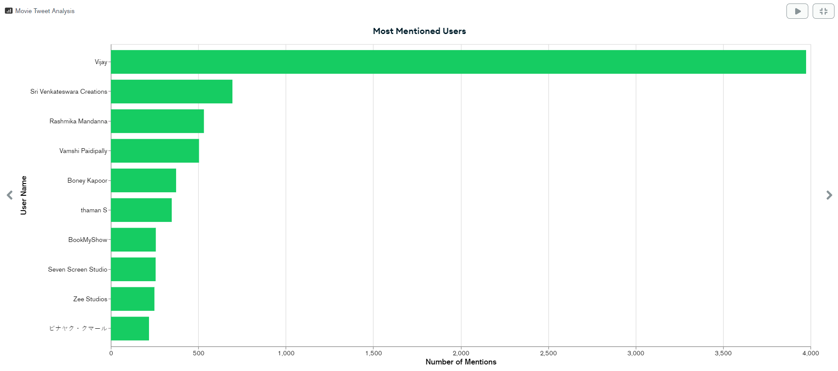
MOST MENTIONED USERS

Slide 33
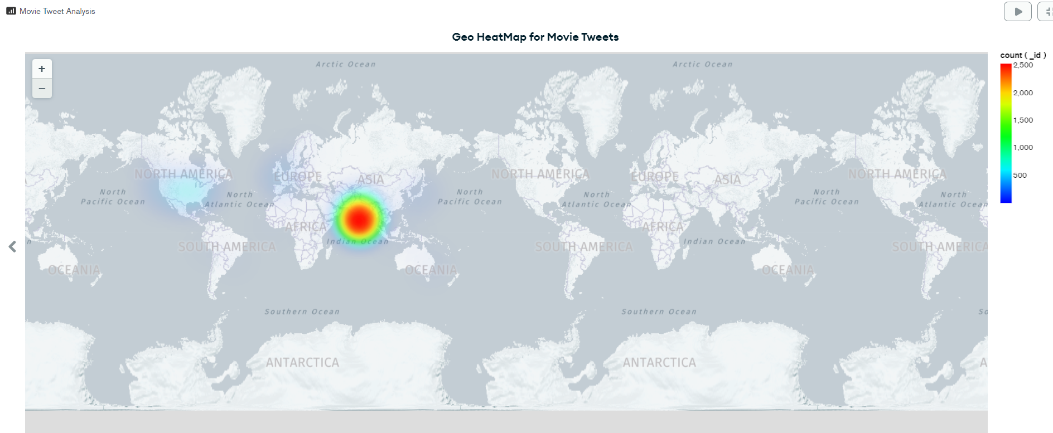
GEO HEATMAP FOR MOVIE TWEETS

Slide 34
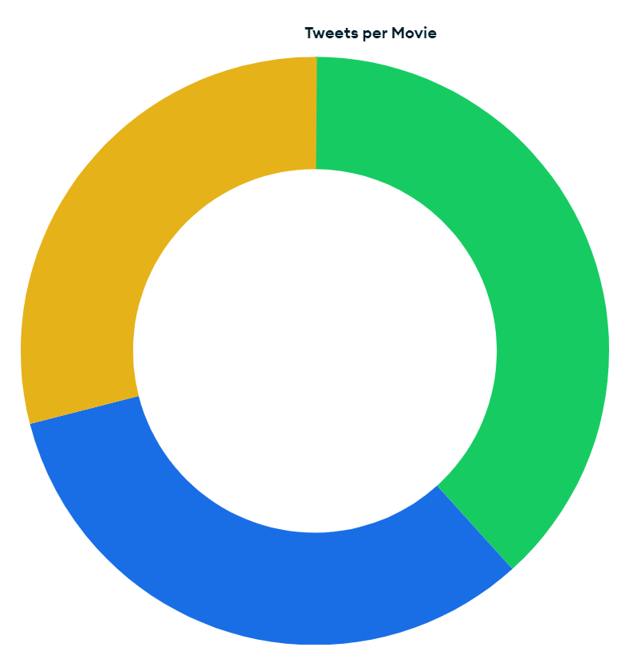
TWEETS PER MOVIE PIECHART

Slide 35
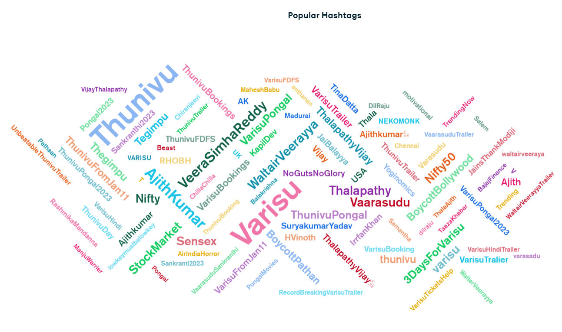
POPULAR HASHTAGS

Slide 36
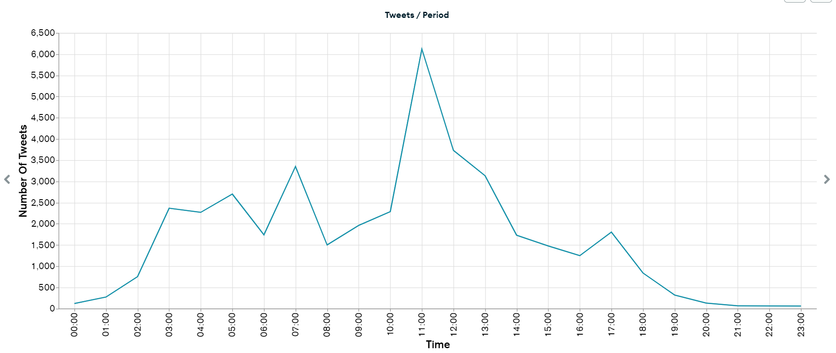
TWEETS/PERIOD

Slide 37
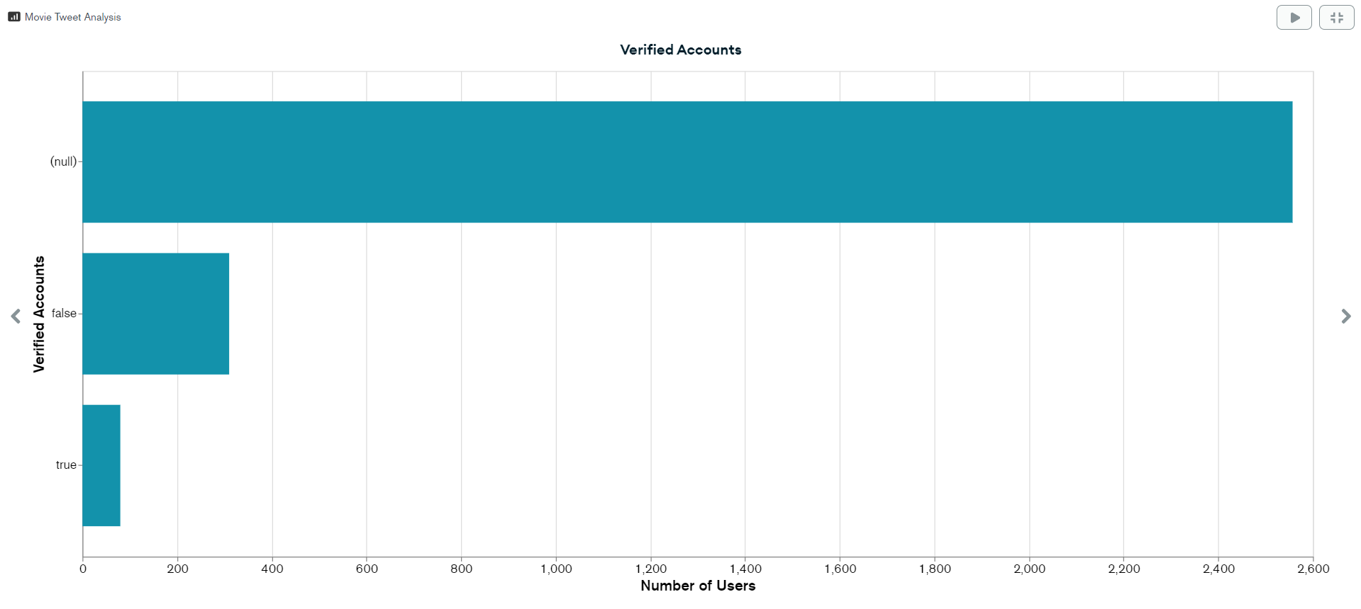
VERFIED ACCOUNTS

Slide 38
Querying MongoDb DataBase:

Slide 39
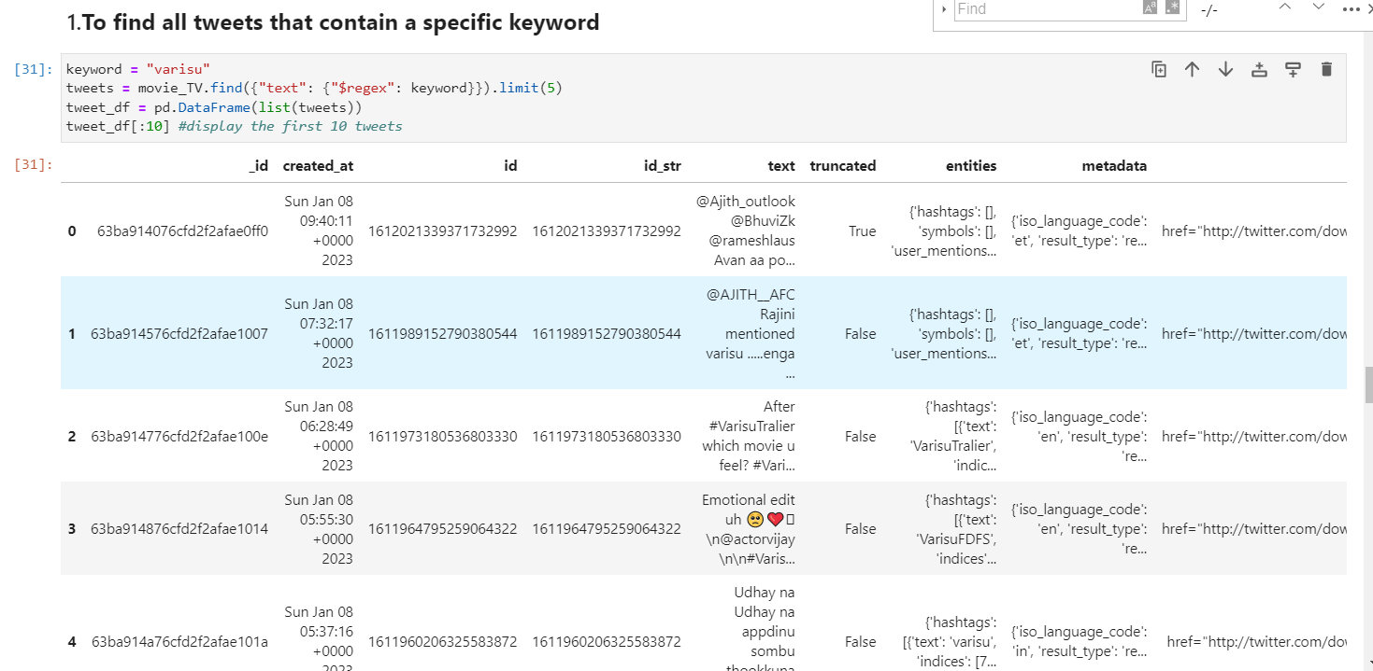

Slide 40
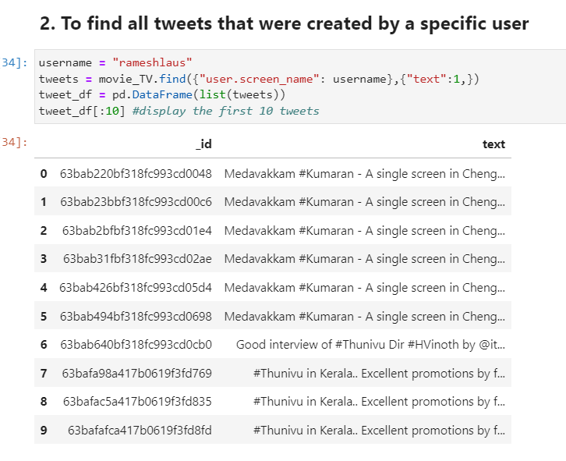

Slide 41
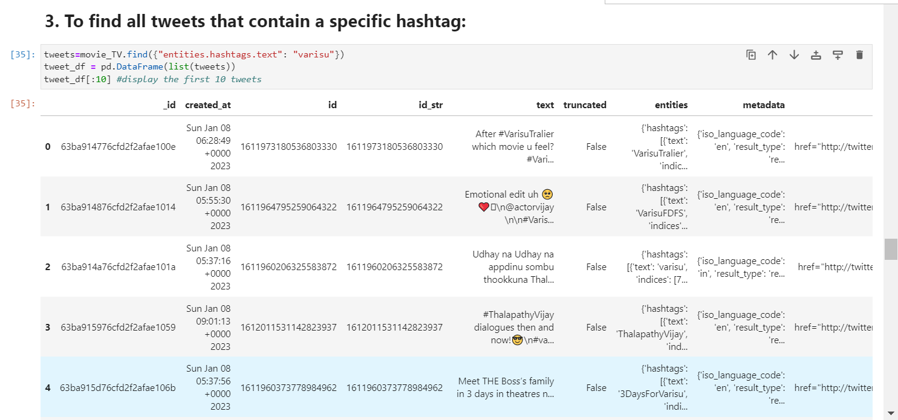

Slide 42
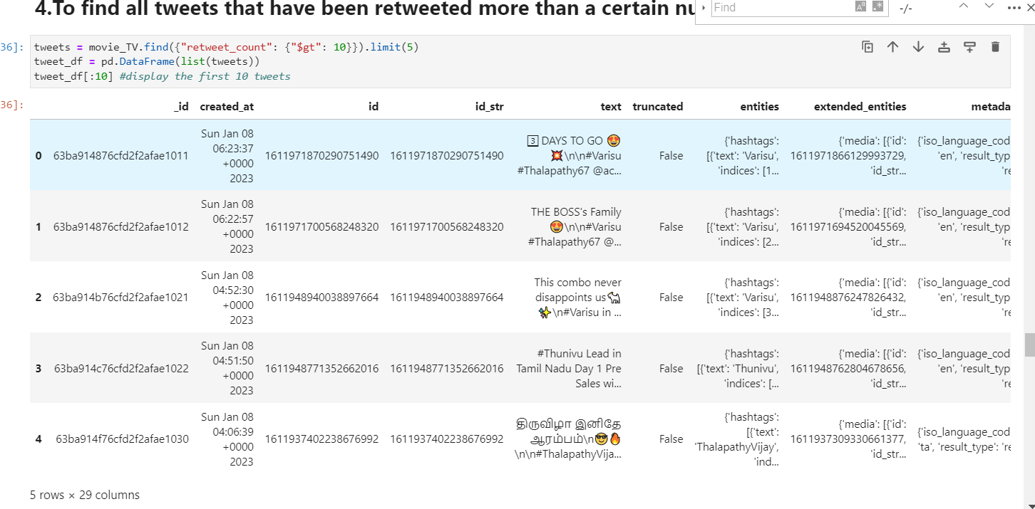

Slide 43
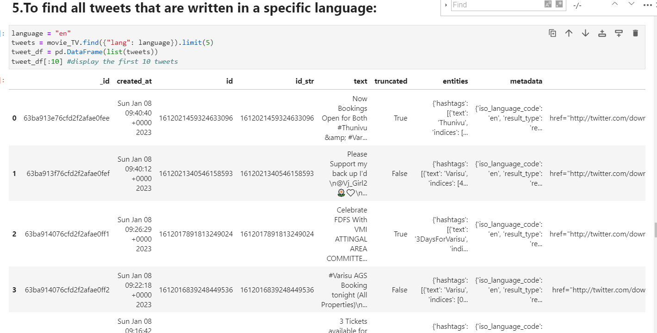

Slide 44
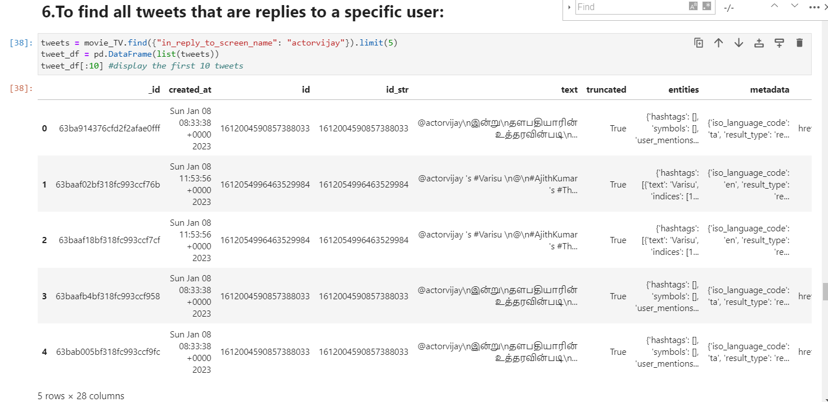

Slide 45
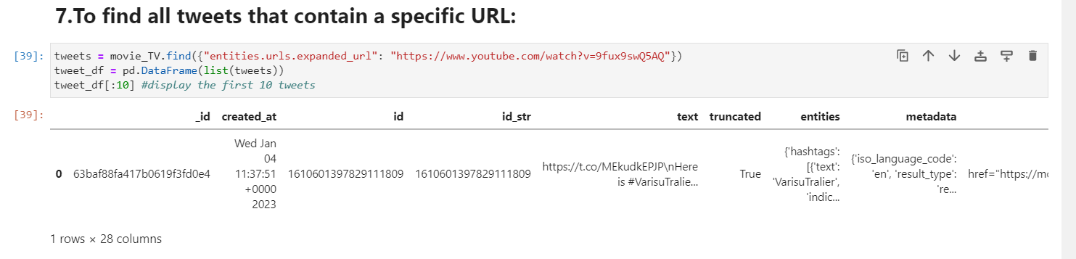

Slide 46
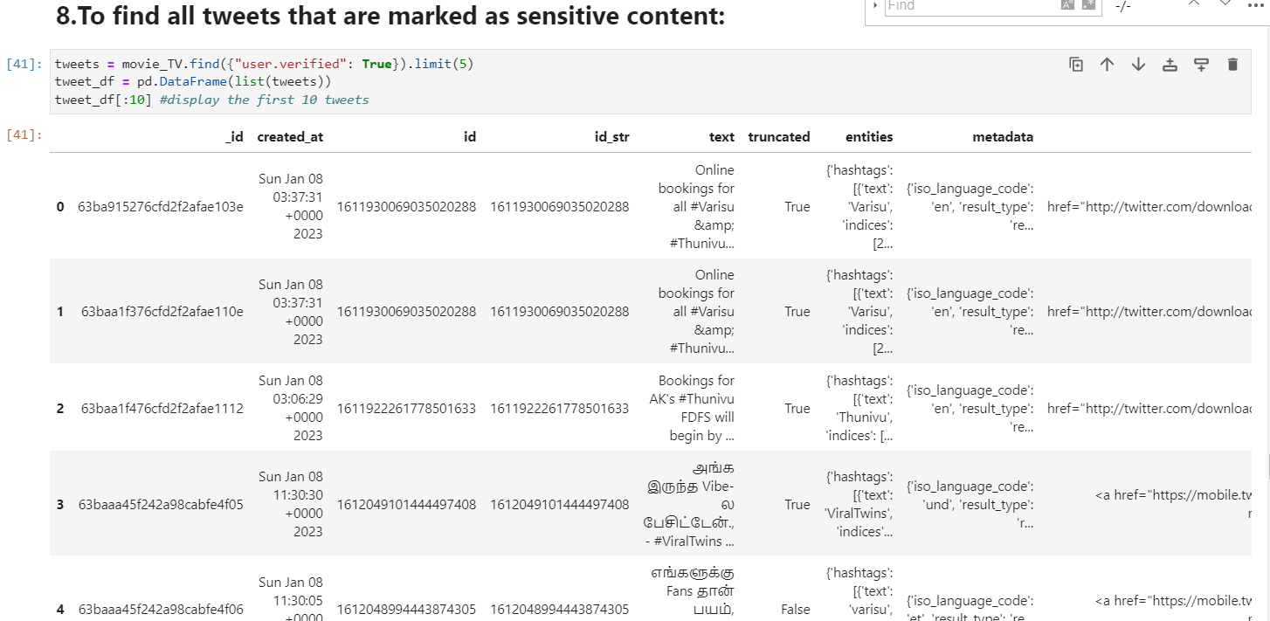

Slide 47
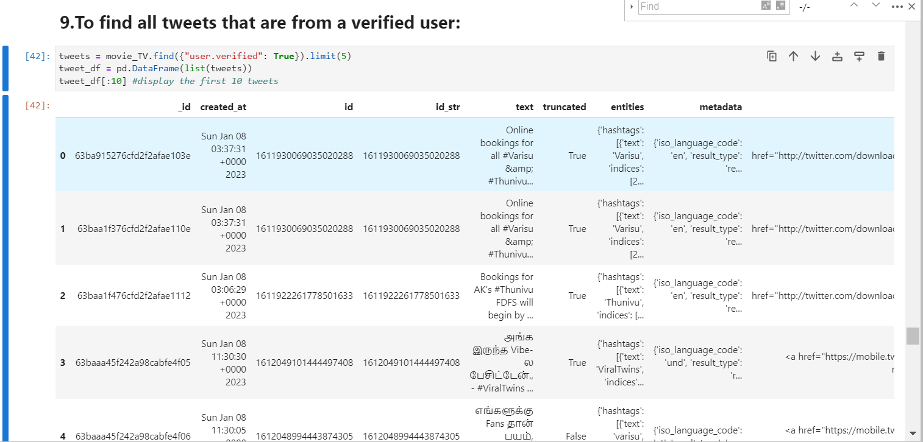

Slide 48
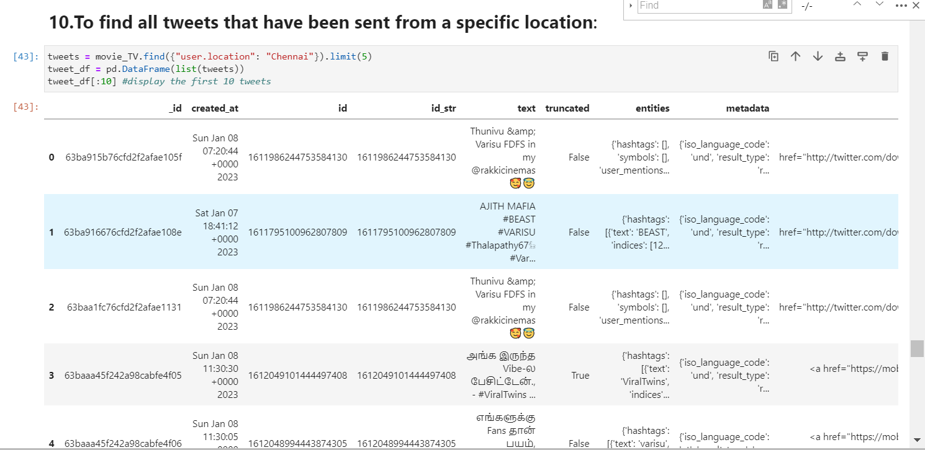

Slide 49
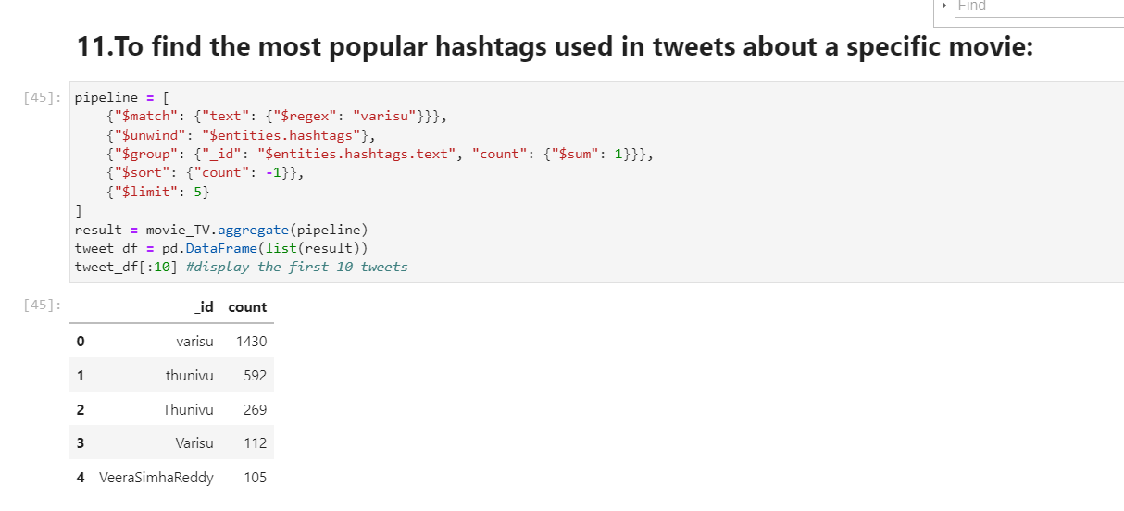

Slide 50
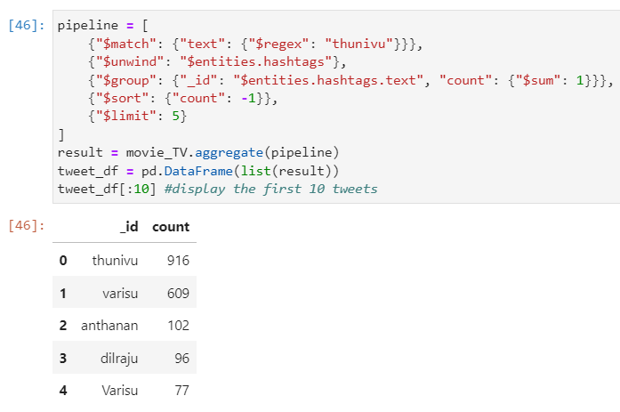

Slide 51
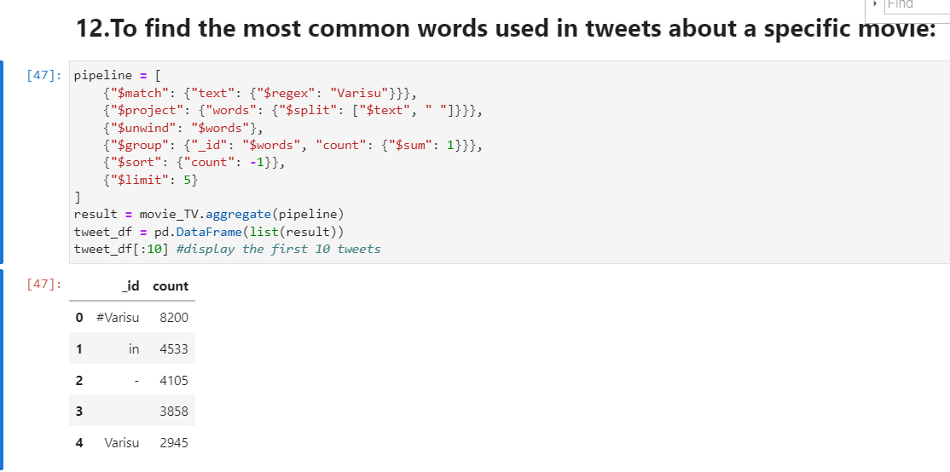

Slide 52
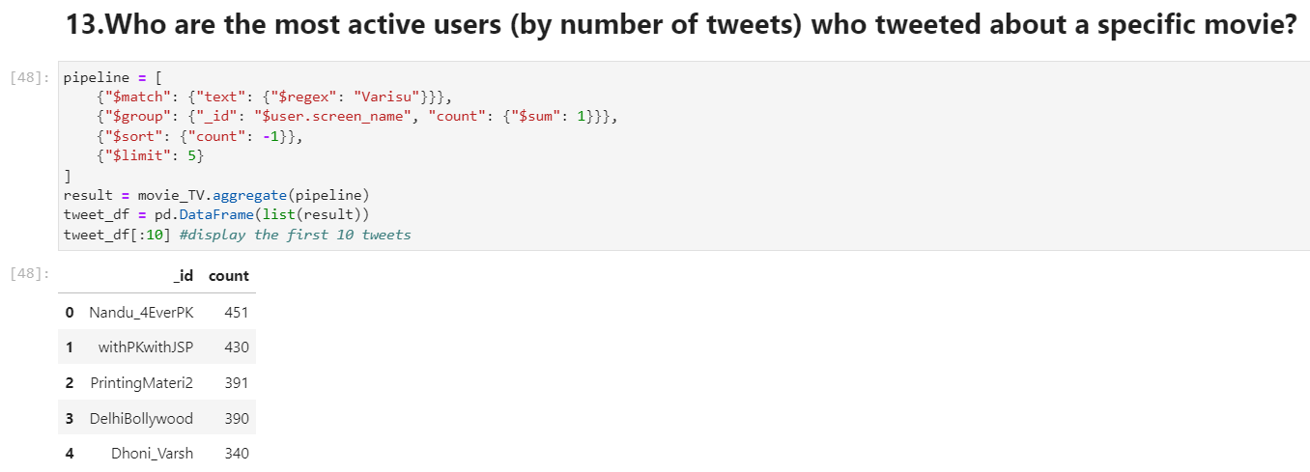

Slide 53
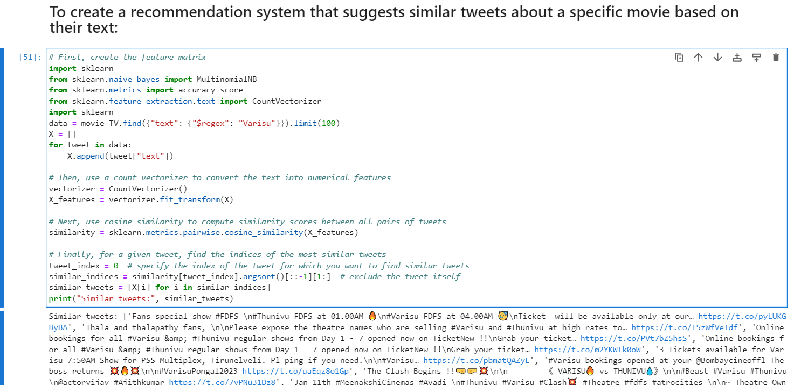
Code_Link

Slide 54
Thank You

